Slide 1

Recommender for building a fitness center in Toronto
Yashas Mohankumar

Slide 2
Introduction
The rising awareness of fitness and its importance for the wellbeing of people led me to choose the issue of locating areas in Toronto where the fitness industry would flourish.
Toronto being one of the biggest metros in the world has a booming population and multiple neighborhoods offering unique opportunities to set up a business
The revenue generated by the fitness industry in Toronto alone was 224 Million USD in 2017 that grew to 350 Million USD in 2020.

Slide 3
Business Problem
The massive revenue and growth have sparked an increasing number of businessmen and fitness enthusiasts alike to get in on the game
The increasing competition in the marketplace requires businesses to make informed decisions about the locations at which new gyms should be open
The recommender tries to look at the clusters of gyms in each area followed by the distribution of types of fitness industries to help the stakeholder to make an informed decision about the location and kind of gym to open.

Slide 4
Methodology
Data was obtained on Neighborhoods and Boroughs in Toronto from Wikipedia
The latitude and longitude was obtained for each of the Boroughs
The Foursquare API was used to obtained different venues in those locations
New data-frame with only gyms was obtained
Clustering was done with 3 clusters on the gym data
Master data-frame was merged with marking them into the same cluster using neighborhood as the join-in clause

Slide 5
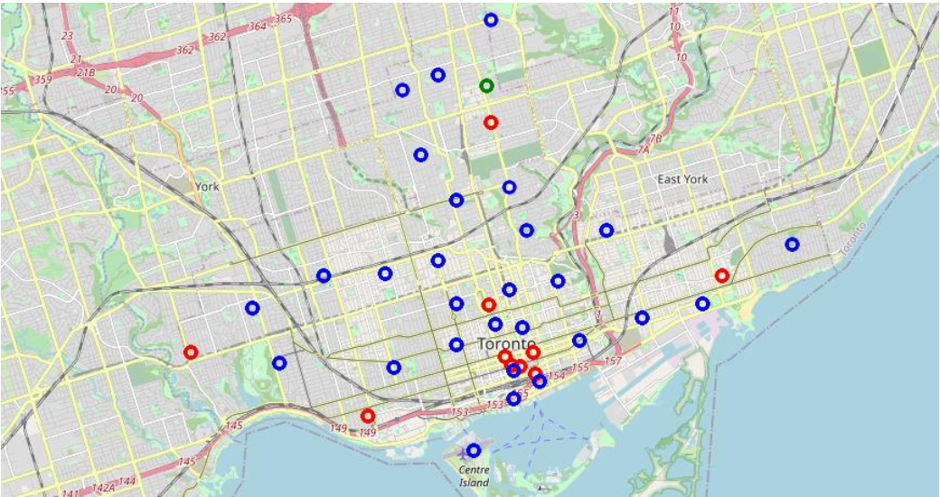
Results
The three clusters obtained are plotted on the graph as shown on the right side.
Cluster 1 is plotted in Blue
Cluster 2 is plotted in Red
Cluster 3 is plotted in Green

Slide 6
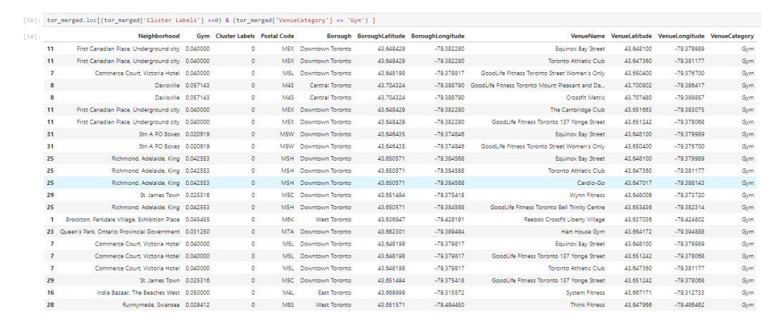
Cluster 1

Slide 7
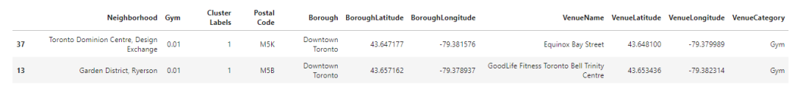
Cluster 2

Slide 8
Cluster 3

Slide 9
Discussion
Based on the analysis of data from Toronto Neighborhood though there is a lot of opportunity to open a gym, most of the gyms are in cluster 1 around the areas of Richmond, St James Town and First Canadian place, the best place to open a gym would be in the areas of cluster 3 around Davisville in Central Toronto.

